Slide 1
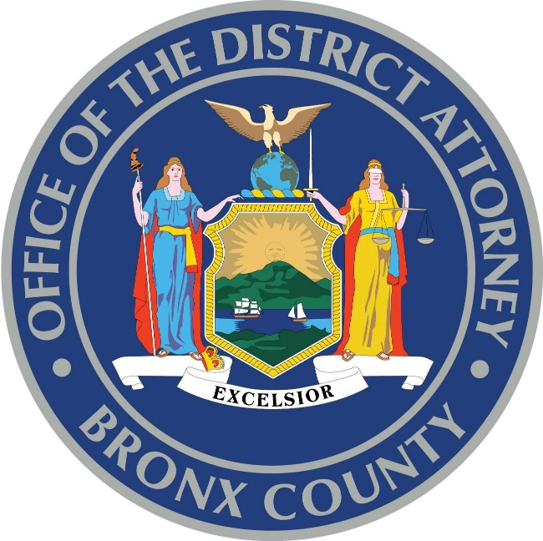
Prosecutorial Innovation
A VIEW FROM THE BRONX
5th Innovation in Prosecution Summit
November 16, 2018

Slide 2
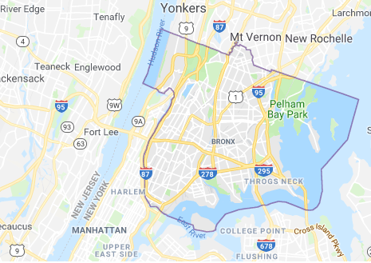
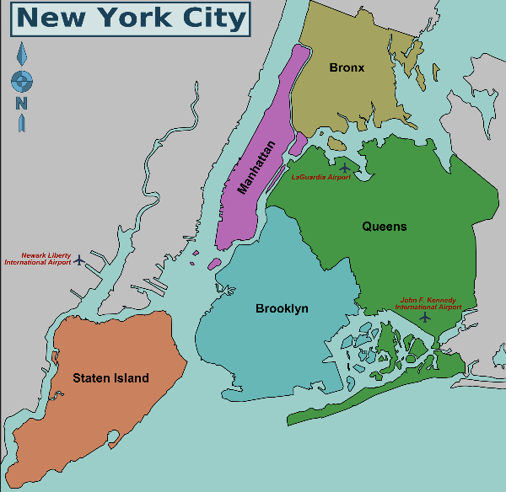

Overview of the Bronx
-1.4 million residents
-57 square miles
-Connected to Manhattan and Queens via waterways
-Median income is $34,299 with per capita income is $18,456
-30% of residents living in poverty

Slide 3
2018 YTD
over 75 homicides
over 210 shooting incidents
over 260 shooting victims
Crime in the Bronx
Notes:
Roughly 17% of the city’s population but approximately 21% of major crime
2017: Nearly 20K index crimes and over 53K arrests
190 Homicides in 2000. 72 last year. 62% decline
(673 Homicides in 2000 in NYC; 292 last year)

Slide 4
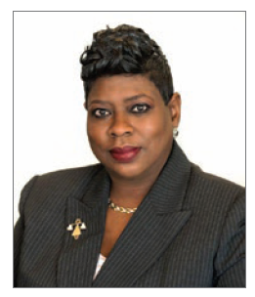
BXDA
2016-Present
- 5th largest prosecutor’s office in the country
-550 lawyers, 500 support staff
Notes:
DA took office in 2016 after BXDA after one DA for over 25 years. Prior DA had no computer on his desk, office structure hadn’t changed much in decades, very little collaboration with other agencies and a not great relationship with NYPD.
What do you do when you inherit an office that can’t support an innovators vision? Lacking infrastructure and reticent to make changes. Where there’s a will there’s a way.
Pursuing Justice with Integrity. How to get there
Vertical Prosecution: Reducing Delays, Responsiveness to community, infusing cases with intelligence
CSU
ATI
Conviction Integrity
Rikers Island Prosecution Bureau
Bail Reform
Misdemeanor Charging
Re-Entry Initiative
Technical Investigations Unit

Slide 5
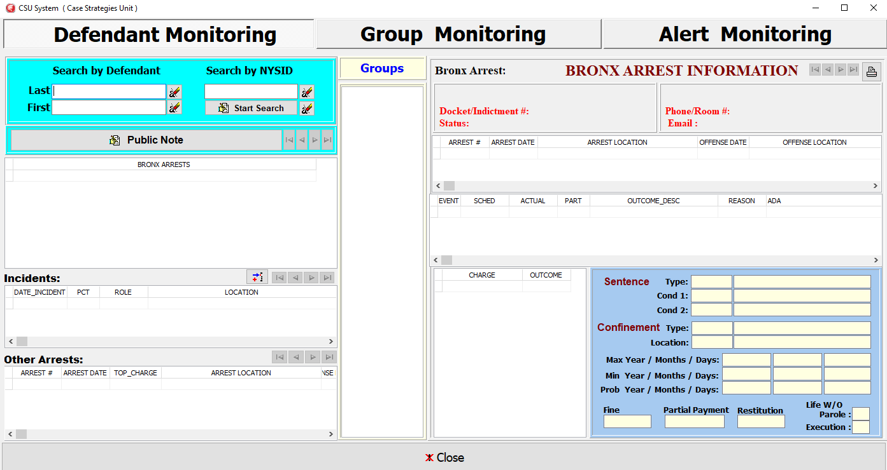
Data Driven Innovation
Challenges:
-Out of date technology
-Reliance on court data
-Strategic plan based on data
-Anecdotes ≠ Policy
-Transparency
Notes:
Out of Date Tech:
Homegrown case management systems that can tell you only where a case is in the office
Too many databases and buckets of info not speaking to each other
No accurate reporting or analytics built into system
Programmers building tools without plan
Reliance on Court Data:
Disposition Data & Policies relating to bail, sentences, diversions is based on OCA data and coded in ways that are no longer clear and not always accurate
Strategic Plan for Data/Anecdotes not equaling policy
Why are we doing what we are doing and how can data help us make justice policies. We did not have the tools to do this.
Example: disposition policies based on what DA said was policy – trust but verify
Example: Arrest Alert System – decent program, not utilized strategically
Transparency
Inability to share data and outcomes with other agencies and community because of lack of confidence

Slide 6
Data Driven Innovation
Some Solutions:
-Crime data
-Harnessing office data
-Data collaborations
-Analysis
Notes:
How to drive change with limited data & pushing back against anecdotes:
Crime focused not case processing focused – Daily VCR with weekly crime stats + gathering data of value and mapping (NFS; BronxCAMS)
1. Our office was not crime focused – how to utilize data and information to change culture
2. Harnessing data coming into the office – BronxCams and video tech retrievals
Data collaborations with NYPD & Others (MOCJ, DCJS, OCA, Parole). Get your data from others while building internal intel
What does it all mean and how to get to analysis:
1. Hired analysts who can quickly analyze raw data – whiz kids with spreadsheets.
2. Data Officer – need to make data a priority in prosecutors offices. Data reports internal and external to drive policy and structure (eg: Kim Foxx)
Move towards off the shelf software that can reduce the buckets of information your IT department keeps building

Slide 7
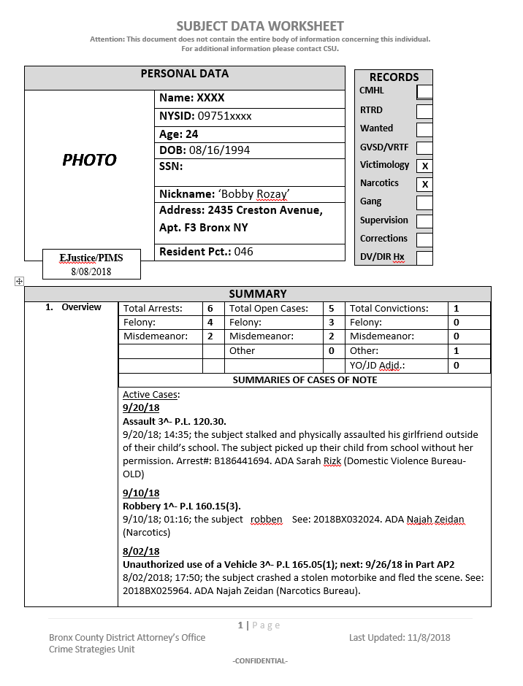
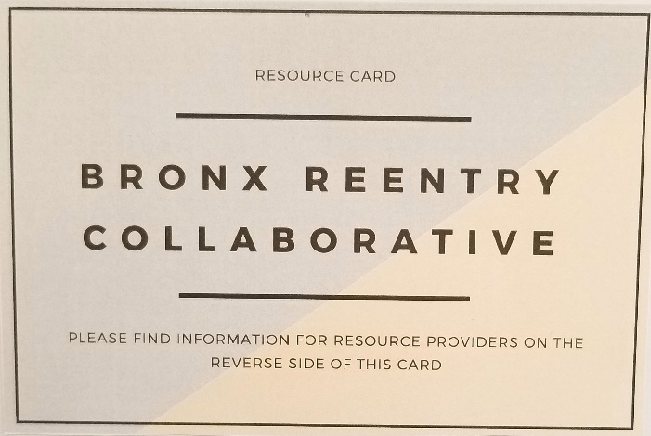
Innovation & Increasing Public Safety
-Focused Prosecutions
-Opioid Overdose Epidemic
-Alternatives To Incarceration
-Re-Entry
Notes:
Strategic prosecutions (more possible with vertical pros)
1. Identifying the crime drivers and using tech/analysts to be prepared for their arrests (pulling from buckets)
2. Utilizing the arrest alert system
3. Creating a relationship with NYPD focused on pub safety
Pushing boundaries of the prosecutor’s role into other public safety concerns: Opioid crisis
1. Analyzing overdoses in the county and how that informs strategies (stats)
2. Working Group (data analysis + strategies)
3. OAR & HOPE (who is getting arrested and what’s the response)
Diverting individuals away from the criminal justice system and reducing collateral consequences:
1. Project Reset – neighborhood justice circles & recidivism
2. Violence diversion - Common Justice
Re-entry Initiative: Pre-entry + Re-entry Collaborations
1. Pre-entry issues like bail, sentencing policies, diversion,
2. Bronx Reentry Collaborative, Reentry Task Force, Resource fairs, collaboration with partners in the community + Parole
a. data needs around who is coming home and how to support their successful re-entrance

Slide 8
Improving Public Policy
-Resource allocation
-Prosecution philosophy
-Redefining policies based on current and historical analysis
Notes:
Resource Allocation:
Structural decisions based on case data (an office in transition)
Prosecution Philosophy/Redefining policies
Bail policy – how we got there
Misdemeanor charging review (charges we anecdotally believed we were no longer charging – how that impacts your tech systems)
Disposition analysis (why are we giving straight ACDS? Is there a conversation to have with NYPD re: arrest policy)
Next steps: Felony review

Slide 9

Kerry Chicon, chiconke@bronxda.nyc.gov
Carmen Facciolo, faccioloc@bronxda.nyc.gov
5th Innovation in Prosecution Summit

