Slide 1
Officer-Involved Shootings
An Overview
Kevin R. Steele
Montgomery County
District Attorney

Slide 2
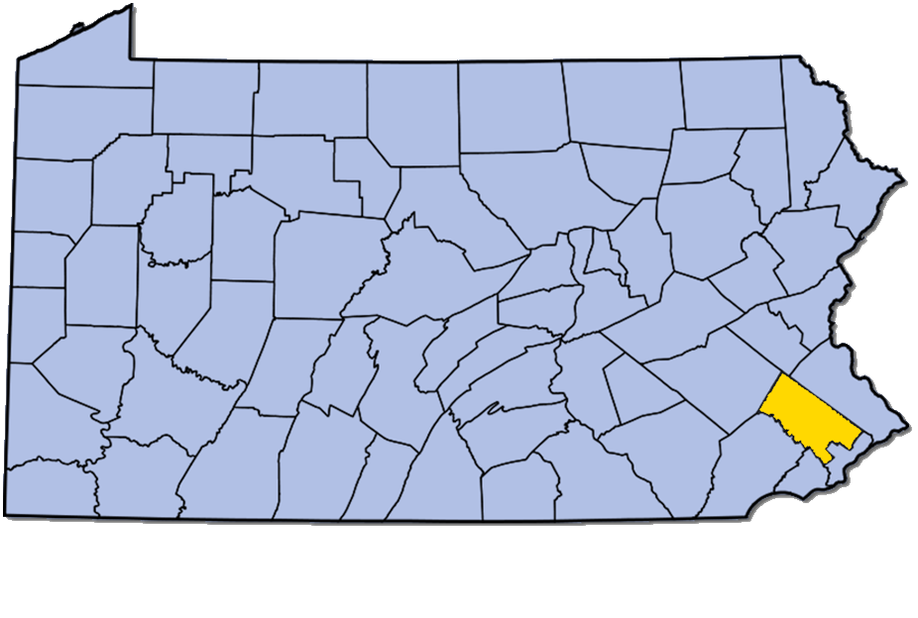
Montgomery County, PA

Slide 3
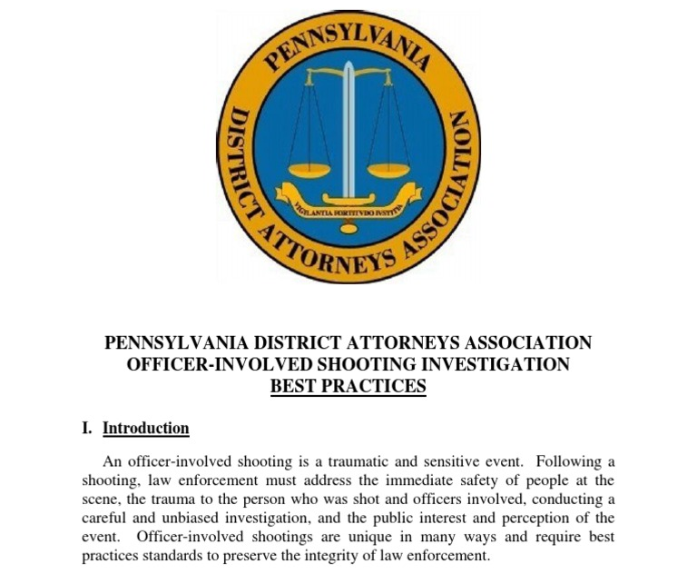

Slide 4
PDAA Best Practices
Released Nov. 29, 2016
16 Recommendations

Slide 5
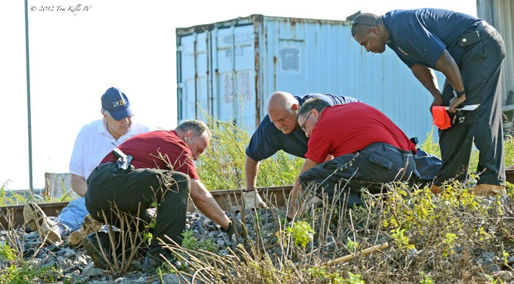
Key Recommendations
Investigations should be independent

Slide 6
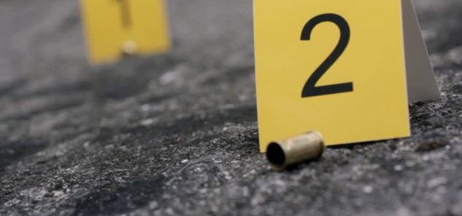
Key Recommendations
District Attorneys should direct the investigation

Slide 7
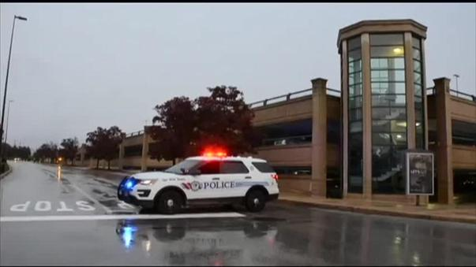
Key Recommendations
On-site safety and security essential

Slide 8
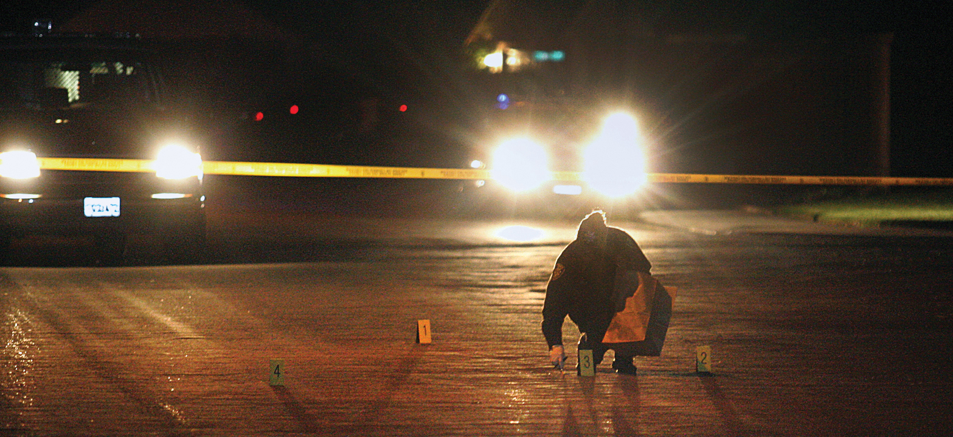
Key Recommendations
Use best-available technology to process scene

Slide 9
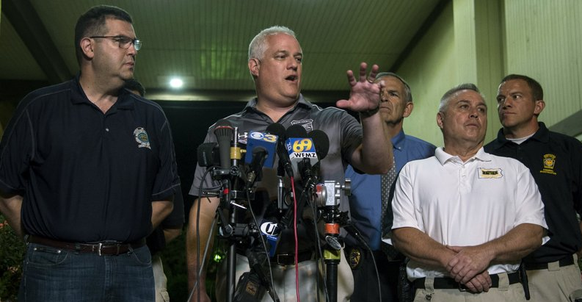
Key Recommendations
Communicate with the public

Slide 10
Rollout of Best Practices
Microsite with news release, interviews with DAs, Chiefs, citizens, mother of son killed in OIS

Slide 11
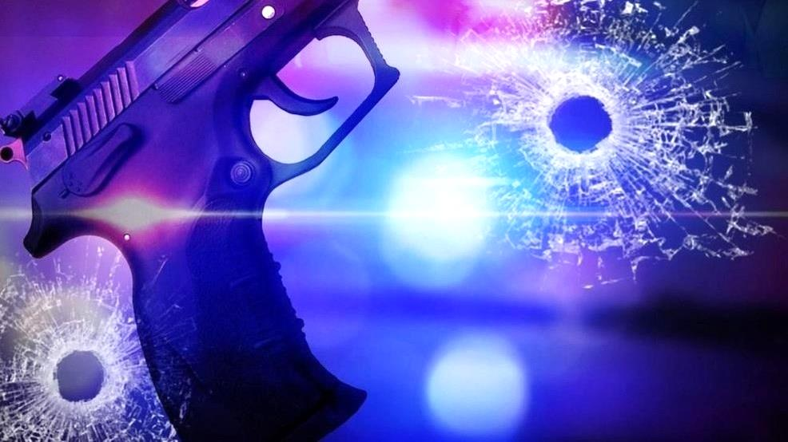
Rollout of Best Practices
Press Release and Interviews

Slide 12
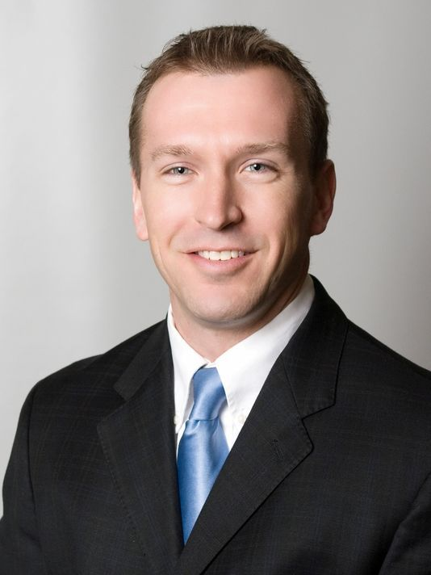
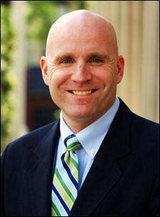
OpEd in The Philadelphia Inquirer

Slide 14
Montgomery County OIS Protocols
Adopted by all Police Chiefs November 2016

Slide 15
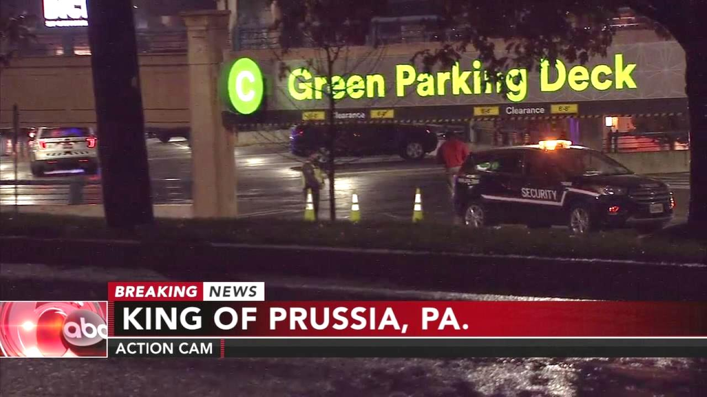
OIS Oct. 29, 2017
4 p.m. Sunday
King of Prussia Mall Parking Deck

Slide 16
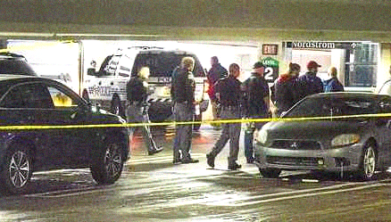
Investigation led by Montgomery County District Attorney

Slide 17
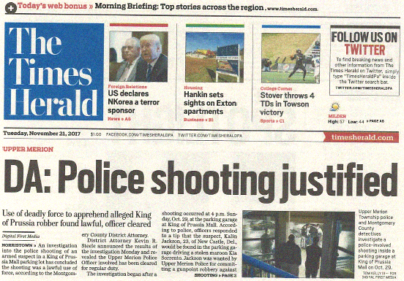
Cleared Nov. 20, 2017

Slide 18
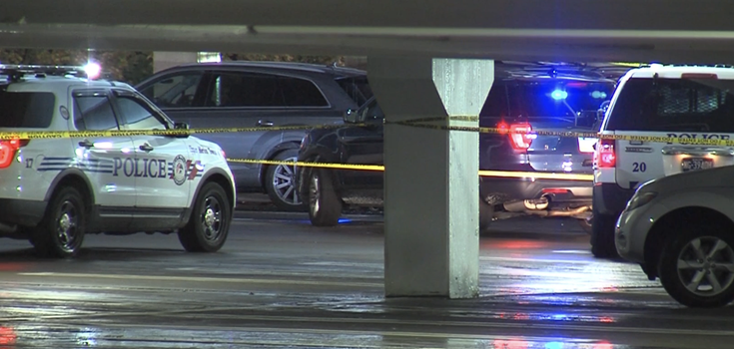
Why the System Worked
Large county with strong DA-Law Enforcement Relationship

Slide 19
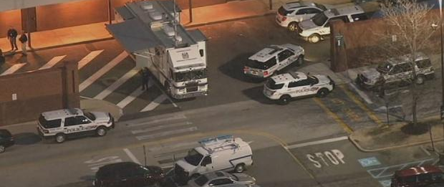
Why the System Worked
County Detectives on-site within minutes; handled scene and investigation overseen by DA

Slide 20
Why the System Worked
Press conference that night with initial information

Slide 21
Challenges with PDAA’s Protocol
DA Office’s with Varying Levels of Resources

Slide 22
Challenges with PDAA’s Protocol
Investigation takes time
Lost time officer is out
Affects department staffing
Especially multiple shooters

Slide 23
Challenges with PDAA’s Protocol
Counties where only Pennsylvania State Police provide coverage

Slide 24
Northampton County Case

Slide 25
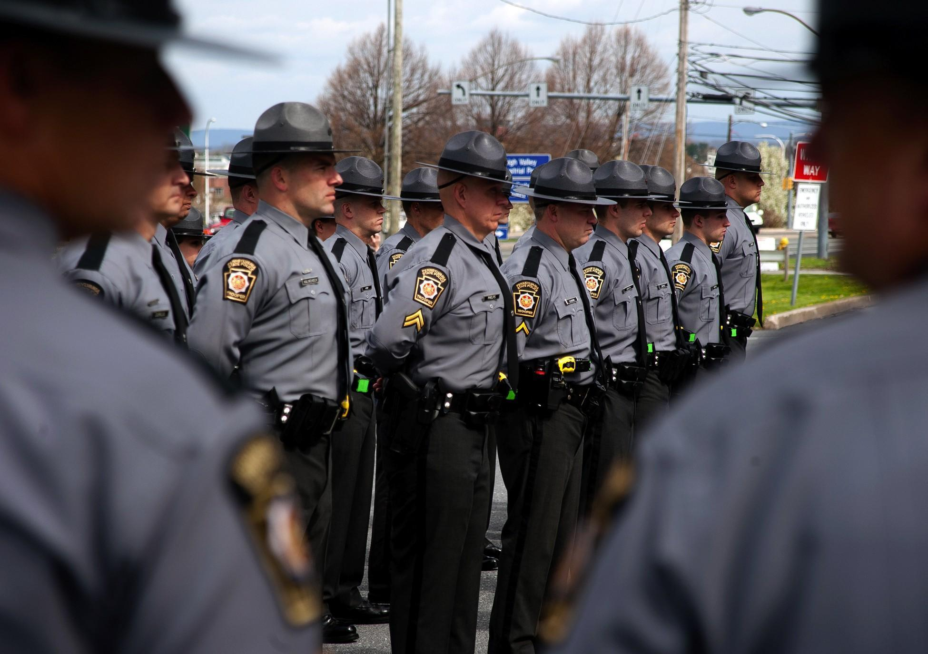
District Attorney vs. State Police

Slide 26
Facts
PSP policy is to investigate their own OIS
PSP refuses to cede authority to DA
PSP runs investigation—clears officers
DA requests Grand Jury to investigate OIS
GJ and DA clear officers involved

Slide 27
Facts
Grand Jury continues probe into shootings and PSP policy
PSP files motion to suppress report
Judge denied
Governor throws support to PSP policy

Slide 29
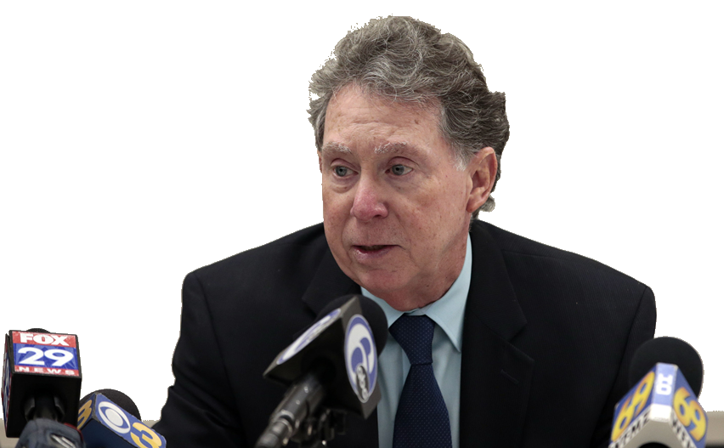
Northampton DA Press Conference
Grand Jury releases report

Slide 30
Grand Jury “strongly recommended” independent agency investigate PSP fatal shootings to ensure transparency

Slide 31
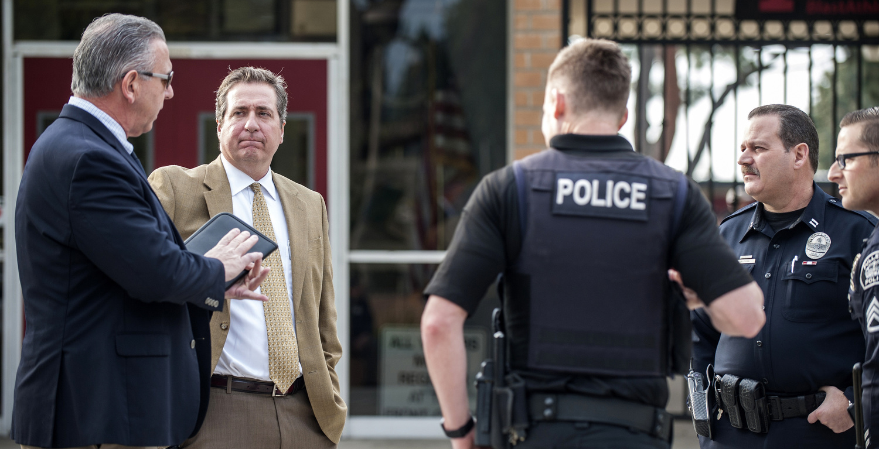
Issues to Consider
“One size fits all”

Slide 32
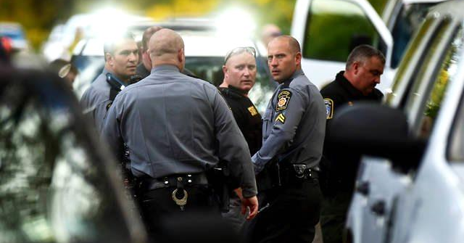
Issues to Consider
Jurisdictions with limited resources

Slide 33
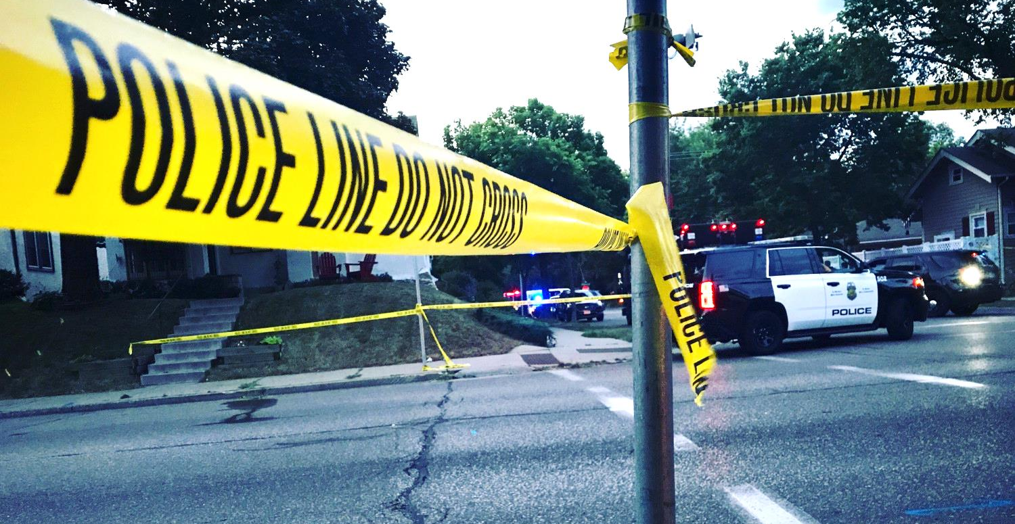
Issues to Consider
Locations with only one LE agency

Slide 34
Issues to Consider
Address issue of how to show videos to officers involved

Slide 35
Issues to Consider
ID officers involved publicly

Slide 36
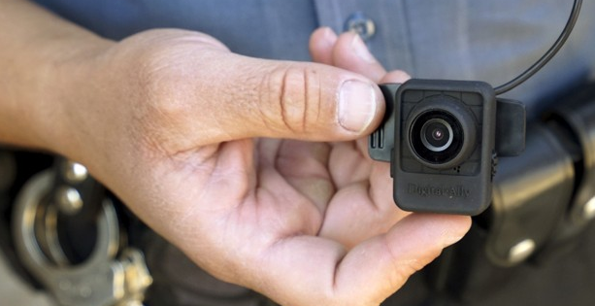
Issues to Consider
Release of video: ever and when?

Slide 37
Officer-Involved Shootings
An Overview
Kevin R. Steele
Montgomery County
District Attorney

