Slide 1
Body Worn Camera Footage and the Prosecutor’s Decision to File
5th Innovation in Prosecution Summit, November 16, 2018
David A. Bozanich, Deputy City Attorney, Prosecution Technology Unit, Los Angeles City Attorney’s Office, Los Angeles, CA

Slide 2
Outline.
1. Research Subject.
2. Research Study.
3. Research Solutions.
4. Q & A.

Slide 3
Research Subject
Los Angeles City Attorney’s Office
Resulting From
Los Angeles Police Department’s
Body Worn Camera Program

Slide 4
Research Subject
Los Angeles Police Department (“LAPD”).
Sworn Officers - 10,037 Civilian Employees - 2,819 City Population Approximation – 4,000,000 Square miles – 468
as of 07/15/2018 per www.lapdonline.org

Slide 5
Research Subject
Los Angeles Police Department’s (“LAPD”) Body Worn Camera (“BWC”) Program.
Special Order No. 12, approved by civilian Board of Police Commissioners, in 2015.
One of Six Bulleted Reasons for BWC Program is to “Collect Evidence for Use in Criminal Investigations and Prosecutions.”
Whereas the Los Angeles County District Attorney’s Office Prosecutes the Felony Crimes That Occur in the City and in the County of Los Angeles, the Los Angeles City Attorney’s Office Prosecutes the Misdemeanor Crimes That Occur in the City of Los Angeles.

Slide 6
Research Subject
LAPD BWC Program.
In June 2016, Los Angeles City Council Approved $69.6 Million Plan to Continue LAPD BWC Program.
Plan Funded Deployment of BWCs for 7000 Uniformed LAPD Officers.
Deployment Done Division by Division (21 Area Divisions, as well as additional Specialized Divisions.)
Deployment Considered Complete as of July 2018.

Slide 7
Research Subject
Los Angeles City Attorney’s Office (“LACA”):
Attorneys – 553 (as of 11/15/2018.) Practice Areas – Criminal, Civil, Municipal, Proprietary. Prosecuting Attorneys – 242 (as of 09/19/2018.) Geographic Criminal Branches – 6.
Specialized Units – 12 (including Gang & Gun Prosecution, Family Violence, Consumer, Environmental & Neighborhood Prosecutors).
LACA Reviewed 79,853 Criminal Cases Per Year for Filing Consideration During Research Period (October 2015 – April 2018.) = Total 200,000+

Slide 8
Research Subject
Of, or in Addition to, the $69.6 Million Allocated by the Los Angeles City Council in June 2016, the Amount That Was Budgeted for the LACA Due to LAPD BWC Evidence in Criminal Investigations and Prosecutions Was:

Slide 9
Research Subject
Of, or in Addition to, the $69.6 Million Allocated by the Los Angeles City Council in June 2016, the Amount That Was Budgeted for the LACA Due to LAPD BWC Evidence in Criminal Investigations and Prosecutions Was:
$ 0

Slide 10
Research Subject
By December 2016, With Only 1000 BWCs Deployed, LACA Already Possessed Approximately 15,000 BWC Recordings.
LACA Requested Funding in 2017.
As of November 15, 2018, LACA Possesses Approximately 95,000 BWC Recordings.
Currently, Average Receipt of 5,000 BWC Recordings Per Month.

Slide 11
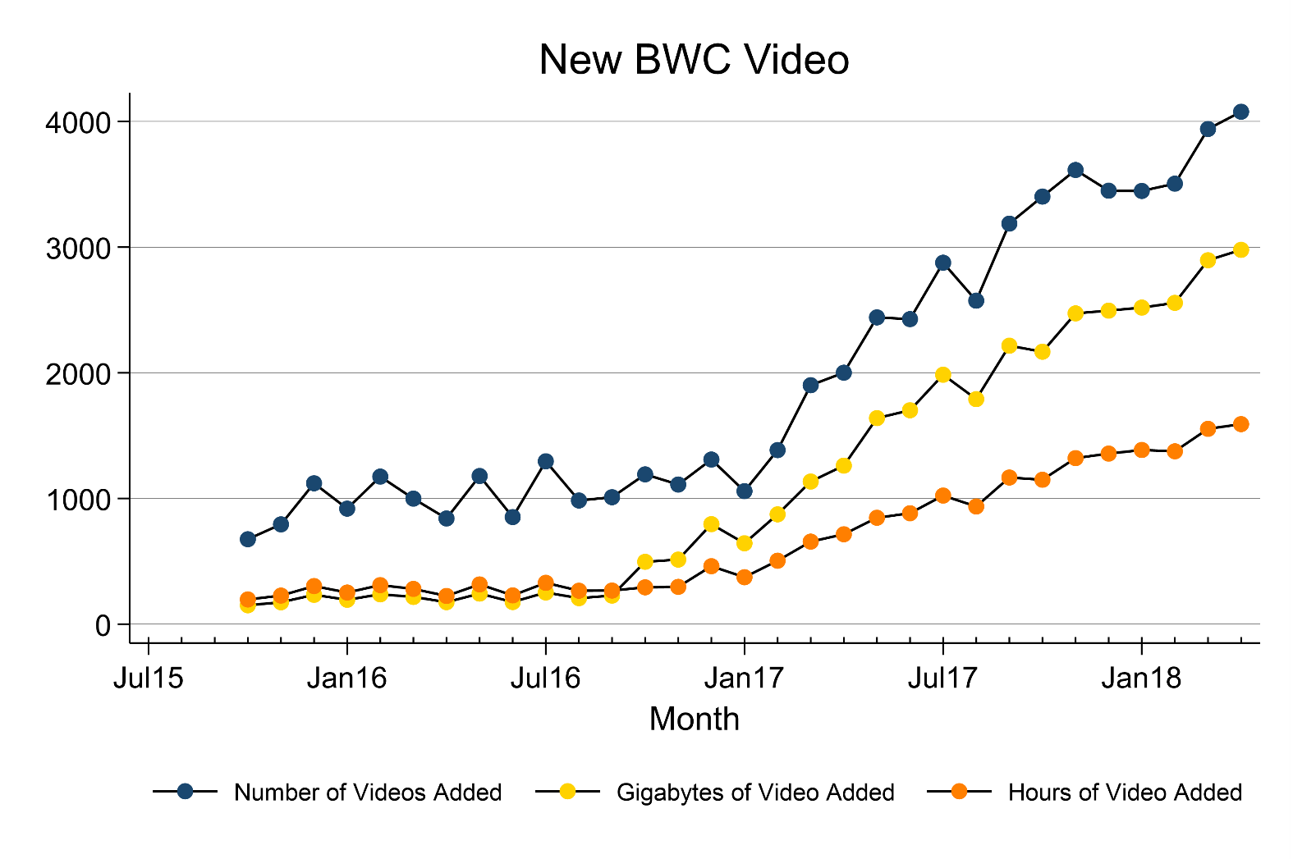
Research Subject

Slide 12
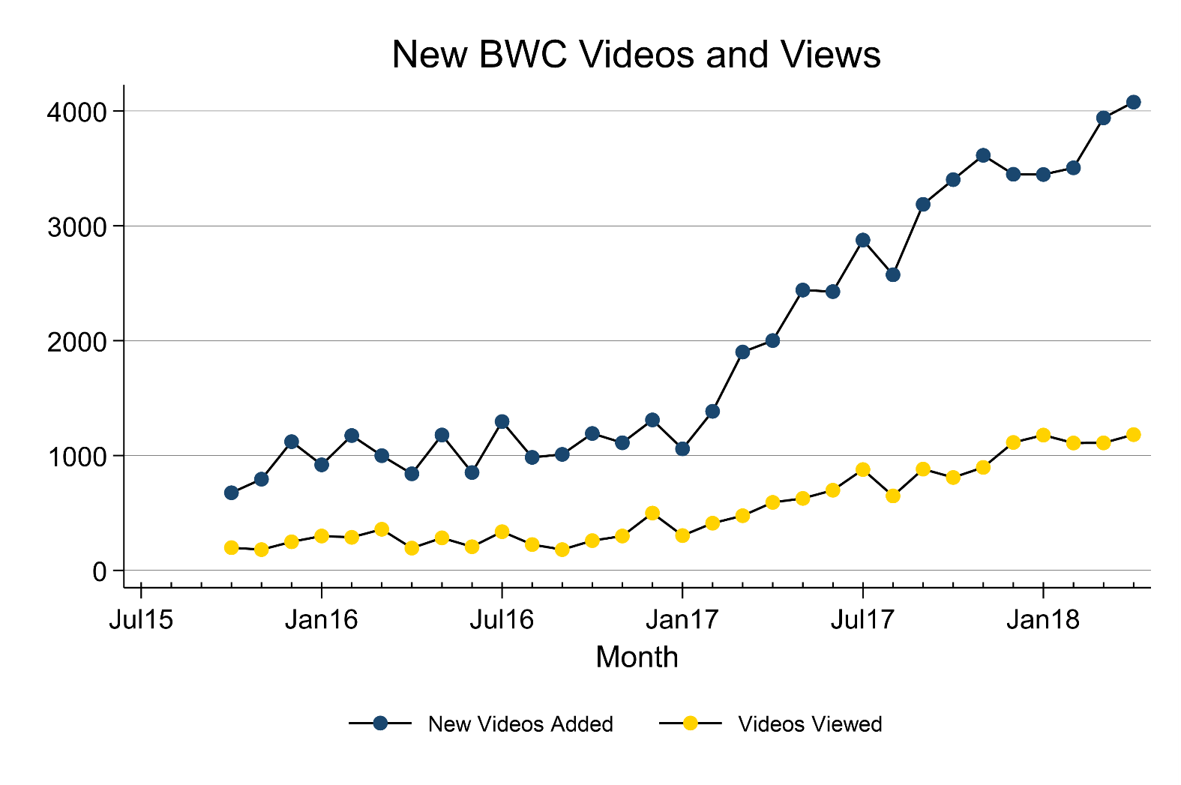
Research Subject

Slide 13
Research Study
Introduction of Research Study Team.
This research was made possible by funding from the Laura and John Arnold Foundation (LJAF).
Elizabeth R. Groff, Ph.D., Professor, Department of Criminal Justice, Temple University, Philadelphia, PA.
Jeffrey Ward, Ph.D., Associate Professor, Department of Criminal Justice, Temple University, Philadelphia, PA.
Julie Wartell, Lecturer, Urban Studies and Planning, University of California San Diego, La Jolla, CA; formerly, Crime Analyst Coordinator, San Diego County District Attorney’s Office, San Diego, CA; formerly, Crime Analyst, San Diego Police Department, San Diego, CA.

Slide 14
Research Study
Research Questions:
1. Does the presence of BWC video footage change the filing rates for crimes?
2. What are the factors that influence whether filing attorneys evaluate BWC video footage in making filing decisions?
3. Does the decision to evaluate BWC video vary by crime type?

Slide 15
Research Study
Research Study Approach.
1. Focus Groups.
15 Deputy City Attorneys (“DCAs”) from 5 Geographic Branches and 2 Specialized Units identified issues and challenges.
Develop a data collection form.
2. Primary Data Collection.
Extent of usage from targeted, in-depth data from 19 DCAs who served as filing attorneys.
Variation in usage by case circumstances – custody, type of misdemeanor, etc.
3. Official Data.
Whether the presence of BWC evidence affected misdemeanor filing rates.
Study period: October 1, 2015 and April 30, 2018.

Slide 16
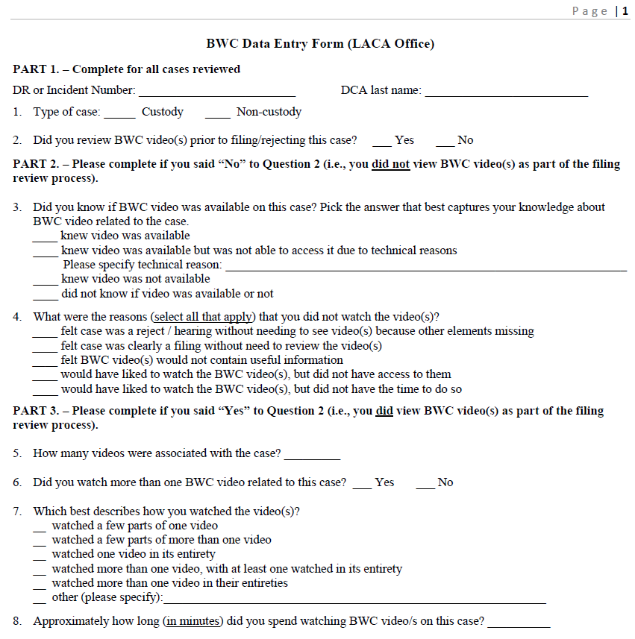
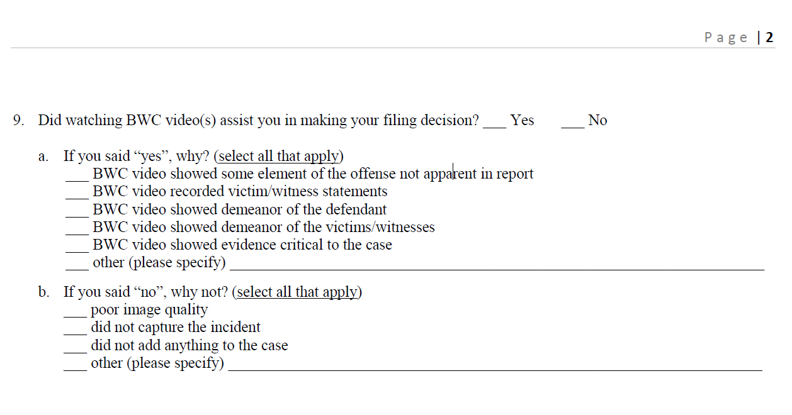
Instrument

Slide 17
Research Study
Research Answers:
1. Does the presence of BWC video footage change the filing rates for crimes?
Yes, but not necessarily in the ways you might suspect.
Notes:
Analyses of official data found that cases were significantly more likely to be filed when BWC video evidence was available as compared to when it was unavailable

Slide 18
Research Study
Research Answers:
1. Does the presence of BWC video footage change the filing rates for crimes?
Cases were significantly more likely to be filed when BWC evidence was available as compared to when it was unavailable.
Interestingly, 72.5% of cases with BWC video that were not viewed were filed, whereas 64.1% of cases that were viewed before the filing decision date were filed. This raises the possibility that the knowledge of BWC availability increases likelihood of filing a case, but less so than actual video viewing.
The overall filing rate for all cases during the study period was considerably lower—52.4% for all offenses. The filing rates were 63.7% for all offenses during the study period that had the same charge codes as the subset of charges with BWC video.
*Until final report is published, numbers and statistics are not final.
Notes:
2017: 52.33% filing rate overall

Slide 19
Research Study
Research Answers:
1. Does the presence of BWC video footage change the filing rates for crimes?
Cases where video was viewed had a lower filing percentage (45.5% versus 51.9%) and a higher rejection rate (45.5% versus 39.0%). If the same proportions occurred in a larger sample, it would suggest that the use of BWC evidence by attorneys reviewing cases reduces the proportion of cases being filed.
Filing rate may be lower when BWC evidence was reviewed prior to filing than when BWC evidence was available but not reviewed.
*Until final report is published, numbers and statistics are not final.
Notes:
2017: 52.33% filing rate overall

Slide 20
Research Study
Research Answers:
2. What are the factors that influence whether filing attorneys evaluate BWC video footage in making filing decisions?
84.3 % - Cases in Which DCAs Did Not Use BWC Evidence Because Case Was a Filing or Reject Without BWC Evidence.
14.4% - Cases for Which BWC Evidence Was Not Used in Filing Because Filing DCA Did Not Know if Video Was Available Or Not.
8.3% - Cases for Which BWC Evidence Was Not Watched, But DCA Indicated Would Have Liked to Watch the BWC Video(s), But Did Not Have Time to Do So.
*Until final report is published, numbers and statistics are not final.

Slide 21
Research Study
Research Answers:
3. Does the decision to evaluate BWC video vary by crime type?
Yes.
Notes:
DCAs suggested that BWC video would be pertinent to domestic violence cases. DCAs also identified the following types of offenses as likely to benefit from having a BWC at the scene: driving under the influence (DUI) especially when the driver refused a field sobriety test; assaults on officers and resisting arrest; and narcotics. The data showed that domestic violence cases were viewed at a higher rate (primary data 4.1% and official data 29.4% versus 1.6% overall). This was also true for DUI cases (primary 5.7% and official 9.4%). Other crime types for which usage was much higher than expected were battery on a police officer (primary 20.4% and official 21.3%) and resisting arrest (primary 11.8% and official 29.3%). Narcotics offenses were not viewed more frequently

Slide 22
Research Study
Research Answers:
3. Does the decision to evaluate BWC video vary by crime type?
Especially Crimes of Domestic Violence, DUI (especially refusals), Battery on a Peace Officer, Resisting Arrest.
In an attempt to provide guidance to prosecutors, offense types were grouped into three broad categories based on the likelihood that BWC evidence could be relevant to the filing decision.
Notes:
DCAs suggested that BWC video would be pertinent to domestic violence cases. DCAs also identified the following types of offenses as likely to benefit from having a BWC at the scene: driving under the influence (DUI) especially when the driver refused a field sobriety test; assaults on officers and resisting arrest; and narcotics. The data showed that domestic violence cases were viewed at a higher rate (primary data 4.1% and official data 29.4% versus 1.6% overall). This was also true for DUI cases (primary 5.7% and official 9.4%). Other crime types for which usage was much higher than expected were battery on a police officer (primary 20.4% and official 21.3%) and resisting arrest (primary 11.8% and official 29.3%). Narcotics offenses were not viewed more frequently

Slide 23
Research Study
Research Answers:
1. Category A includes all offenses likely to be captured on BWC, in whole or in part. In other words, the entire offense is likely to be captured on BWC or at least one element of the offense is likely to be captured on BWC.
2. Category B includes all offenses not in Category A in which stronger circumstantial evidence is likely to be captured on BWCs, such as the effect of the offense (e.g., injury, damage, etc.), statements regarding the offense by the defendant, victim and/or witness, and the demeanor of the defendant, victim and/or witness.
3. Category C includes offenses not in Categories A or B in which weaker circumstantial evidence is likely to be captured on BWCs, if at all.
Notes:
DCAs suggested that BWC video would be pertinent to domestic violence cases. DCAs also identified the following types of offenses as likely to benefit from having a BWC at the scene: driving under the influence (DUI) especially when the driver refused a field sobriety test; assaults on officers and resisting arrest; and narcotics. The data showed that domestic violence cases were viewed at a higher rate (primary data 4.1% and official data 29.4% versus 1.6% overall). This was also true for DUI cases (primary 5.7% and official 9.4%). Other crime types for which usage was much higher than expected were battery on a police officer (primary 20.4% and official 21.3%) and resisting arrest (primary 11.8% and official 29.3%). Narcotics offenses were not viewed more frequently

Slide 24
Research Study
Additional Major Findings.
Low usage of BWC video in filing decision.
Usage under 8%.
Time and Access.
Custody filings had almost twice as high usage than non-custody cases.
Average time spent reviewing video: 21 minutes.
Despite low usage of BWC evidence in filing decision, 90% of filers believed it assisted in filing decision.
3. Why low usage if assistive?
Average Number of Videos Per Case: 4.5-5.6
Average Length of Videos in Minutes Per Case: 135-139
*Until final report is published, numbers and statistics are not final.

Slide 25
Research Solutions: Teamwork, Technology, Training & Time
Teamwork.
Communicate and Collaborate with Law Enforcement Agencies (“LEAs”) That Submit Cases for Filing Consideration.
Obtain and Understand Protocol of BWC Program.
Know, Establish or Adjust Protocol of Sharing of BWC Evidence.
If Multiple LEAS with BWC Programs, Especially if BWC Programs Utilize Different Technologies, Then Arrange Multi-Agency Meeting to Coordinate Similarities in Sharing, When Possible.

Slide 26
Research Solutions: Teamwork, Technology, Training & Time
Teamwork.
When to Share?
Sharing of BWC Evidence Should Occur Upon Submission of Any Case for Filing Consideration.
What to Share?
Sharing of BWC Evidence Should Include All Recordings Made Because of Case, and Only All Recordings Made Because of Case.
How to Share?
Sharing of BWC Evidence Should Be Exact Copy of Recordings.
Sharing of BWC Evidence Should Be Grouped Into Case/Folder Inclusive of And Exclusive To All Recordings Made Because of Case.
With Whom to Share?
Whether Recordings Be Shared With Entire Office, Specific Branch/Unit, And/Or Individual Attorneys.
If Multiple LEAs, Request Unique Identifiers to Distinguish One LEA from Another in Case Identifying Numbers Can Be Duplicative.

Slide 27
Research Solutions: Teamwork, Technology, Training & Time
Teamwork.
Facilitation of What to Share and How to Share?
Each Individual Recording Should Be Identified by LEA Or Individual Officers Particular to Filing Submission.
e.g., Incident Number, DR/Report Number, Event Number.
Reporting Officers Should Identify Each And Every Officer That Responded to Incident in Report.
Reporting Officers Should Identify Whether BWCs Were Activated.
Reporting Officers Should Identify Which Officer Observed Which Evidence And, if Possible, When Such Evidence Was Observed.
Notes:
When to Share?
Sharing of BWC Evidence Should Occur Upon Submission of Any Case for Filing Consideration.
What to Share?
Sharing of BWC Evidence Should Include All Recordings Made Because of Case, and Only All Recordings Made Because of Case.
How to Share?
Sharing of BWC Evidence Should Be Exact Copy of Recordings.
Sharing of BWC Evidence Should Be Grouped Into Case/Folder Inclusive of And Exclusive To All Recordings Made Because of Case.
With Whom to Share?
Whether Recordings Be Shared With Entire Office, Specific Branch/Unit, And/Or Individual Attorneys.
If Multiple LEAs, Request Unique Identifiers to Distinguish One LEA from Another in Case Identifying Numbers Can Be Duplicative.

Slide 28
Research Solutions: Teamwork, Technology, Training & Time
Technology.
If Technology Does Not Support Efficient and Effective Review of BWC Evidence, Personnel Is Inefficient.
1. Bandwidth.
2. Computers, Operating Systems & Browsers.
3. Monitors.
4. Headphones.
5. Storage.

Slide 29
Research Solutions: Teamwork, Technology, Training & Time
Training – Technological and Logistical.
Train Filing Attorneys On Effective And Efficient Use of BWC Evidence Platform(s).
How to Use BWC Evidence Platform(s).
Sign In Process.
How to Search for BWC Evidence.
Understand Any Sharing Protocol Established With LEA.
Understand Evidence Identification and Organization.
Be Mindful of Clues Regarding Which Recordings May Contain Key Evidence.
Title of Recording, Time of Recording, Which Officer Made Recording

Slide 30
Research Solutions: Teamwork, Technology, Training & Time
Training – Legal.
“In our system, so long as the prosecutor has probable cause to believe that the accused committed an offense defined by statute, the decision whether or not to prosecute, and what charge to file or bring before a grand jury, generally rests entirely in his discretion.”
“Within the limits set by the legislature’s constitutionally valid definition of chargeable offenses, ‘the conscious exercise of some selectivity in enforcement is not in itself a federal constitutional violation’ so long as ‘the selection was [not] deliberately based upon an unjustifiable standard such as race, religion, or other arbitrary classification.’ (Citation.)”
“There is no doubt that the breadth of discretion that our country’s legal system vests in prosecuting attorneys carries with it the potential for both individual and institutional abuse. And broad though that discretion may be, there are undoubtedly constitutional limits upon its exercise.”
Bordenkircher v. Hayes (1978) 434 U.S. 357, 364, 54 L. Ed. 2d 604, 611-12, 98 S. Ct. 663, 668-69.

Slide 31
Research Solutions: Teamwork, Technology, Training & Time
Training – Legal.
“The prosecutor in a criminal case shall:
(a) refrain from prosecuting a charge that the prosecutor knows is not supported by probable cause;
(d) make timely disclosure to the defense of all evidence or information known to the prosecutor that tends to negate the guilt of the accused or mitigates the offense, and, in connection with sentencing, disclose to the defense and to the tribunal all unprivileged mitigating information known to the prosecutor, except when the prosecutor is relieved of this responsibility by a protective order of the tribunal[.]”
American Bar Association, Model Rules of Professional Conduct, Rule 3.8, Special Responsibilities of a Prosecutor.

Slide 32
Technology, Training & Time
Time.
Prosecutors’ Center for Excellence: Recently repeated loose estimation that one position needed for every 100 cameras in the field.
135 Minutes on Average Per Case X 79,853 Cases Per Year = 89.8 Full Time Equivalents.
In Second Half of 2017, LACA Created Prosecution Technology Unit: 7 Attorneys, 7 Paralegals, 4 Interns.
*Until final report is published, numbers and statistics are not final.
Notes:
4492 weeks.

Slide 33
Q & A
?????????????????????????????????????????????????????????????

Slide 34
Body Worn Camera Footage and the Prosecutor’s Decision to File
David A. Bozanich, Deputy City Attorney, Prosecution Technology Unit, Los Angeles City Attorney’s Office, Los Angeles, CA
david.bozanich@lacity.org

